Slide 1
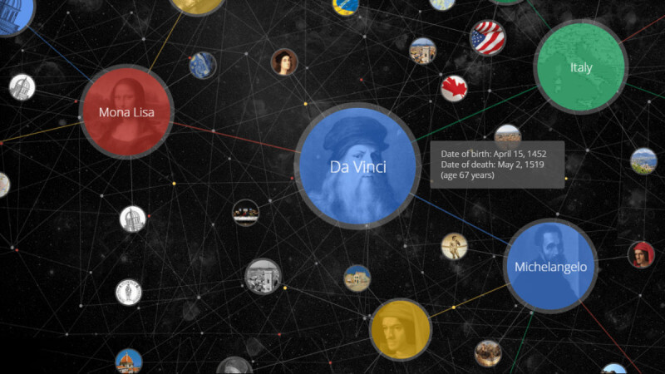
Knowledge Graph Embedding
Tianxiao li

Slide 2
Outline
Introduction to Knowledge Graphs
Knowledge Graph Embedding
Translational methods
Similarity-based methods
Additional information, graphical contexts

Slide 3

Outline

Slide 4
Knowledge Graph
What is a knowledge graph? (from Wikipedia)
A knowledge graph is a knowledge base that uses a graph-structured data model or topology to integrate data.
Knowledge graphs are often used to store interlinked descriptions of entities – objects, events, situations or abstract concepts – with free-form semantics.

Slide 5
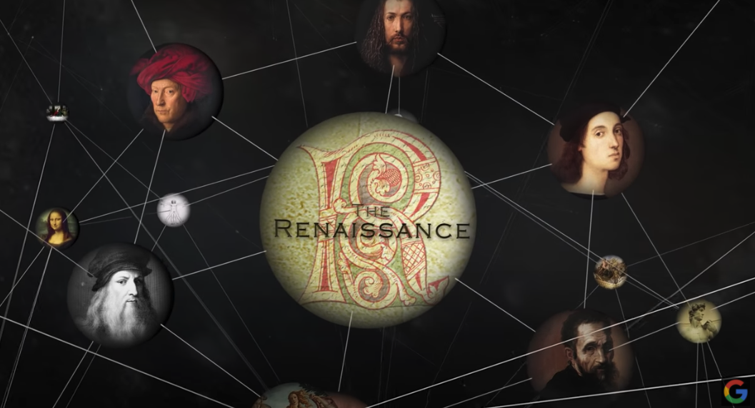
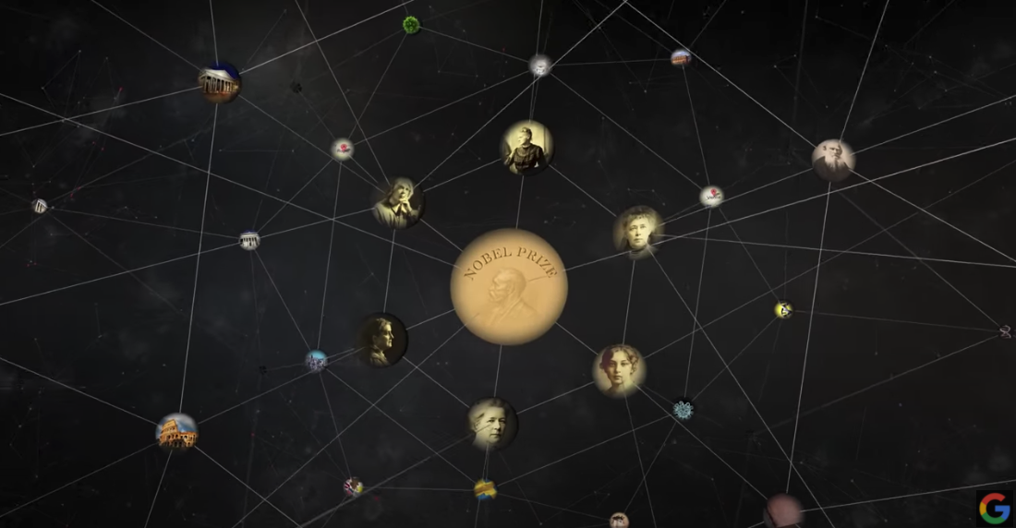
Knowledge Graph
Google Knowledge Graph

Slide 6
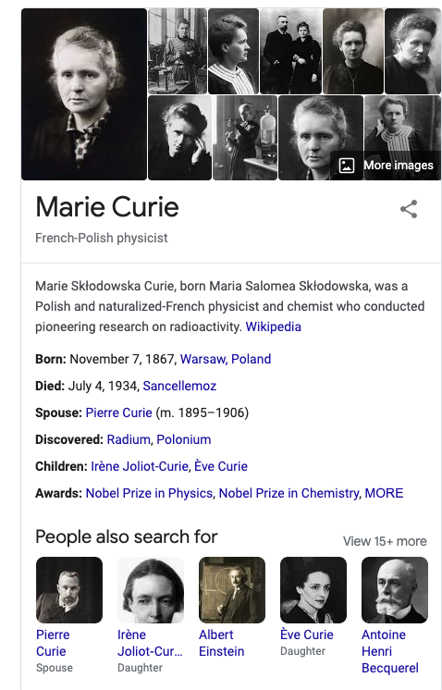
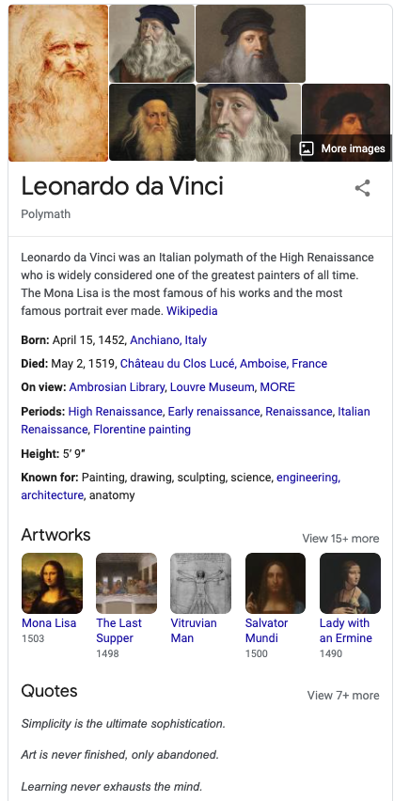
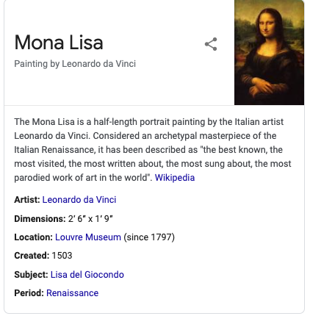

Slide 7
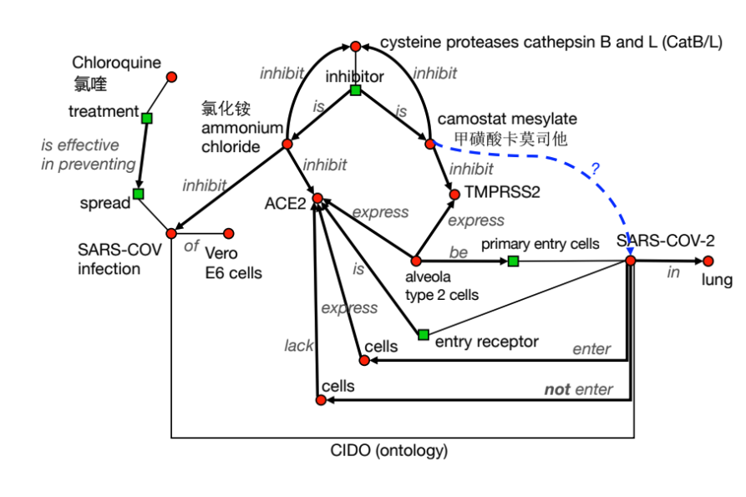
Knowledge Graph
Scientific Knowledge Graph
http://www.meng-jiang.com/tutorial-kdd20-scikg/part3-2_jiang.pdf

Slide 8
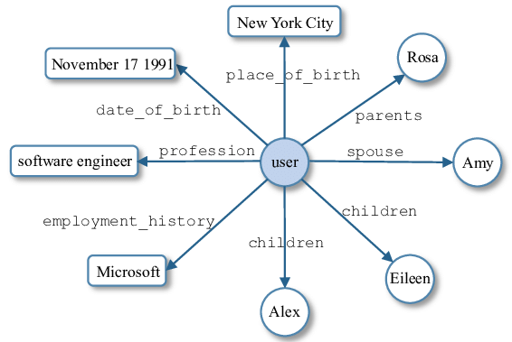
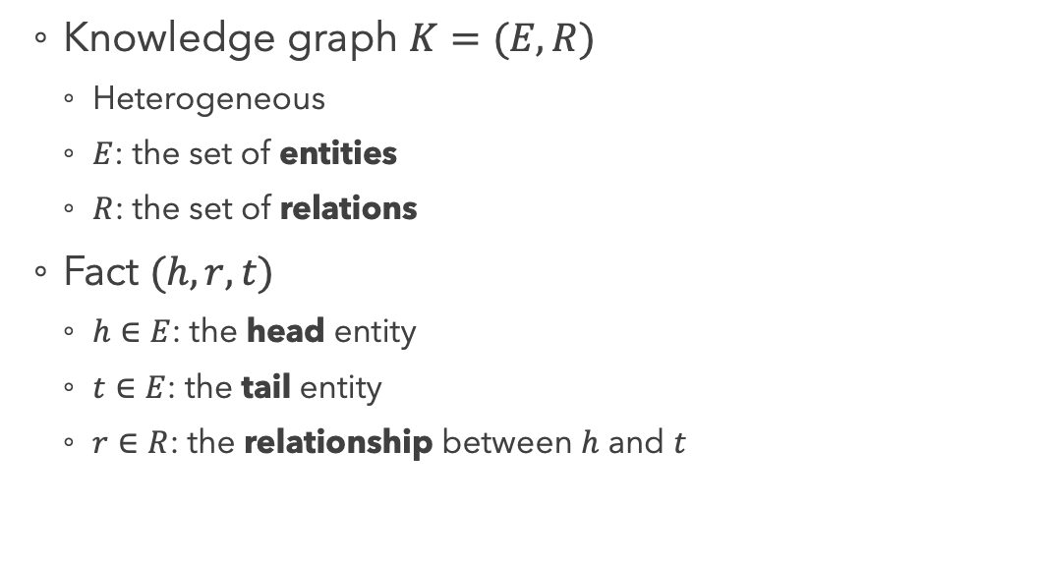
Knowledge Graph
Knowledge graph $K=(E, R)$
Heterogeneous
$E$: the set of entities
$R$: the set of relations
Fact $(h, r, t)$
$h∈E$: the head entity
$t∈E$: the tail entity
$r∈R$: the relationship between $h$ and $t$
Li, Xiang, et al. "Personal knowledge graph population from user utterances in conversational understanding." 2014 IEEE Spoken Language Technology Workshop (SLT). IEEE, 2014.

Slide 9
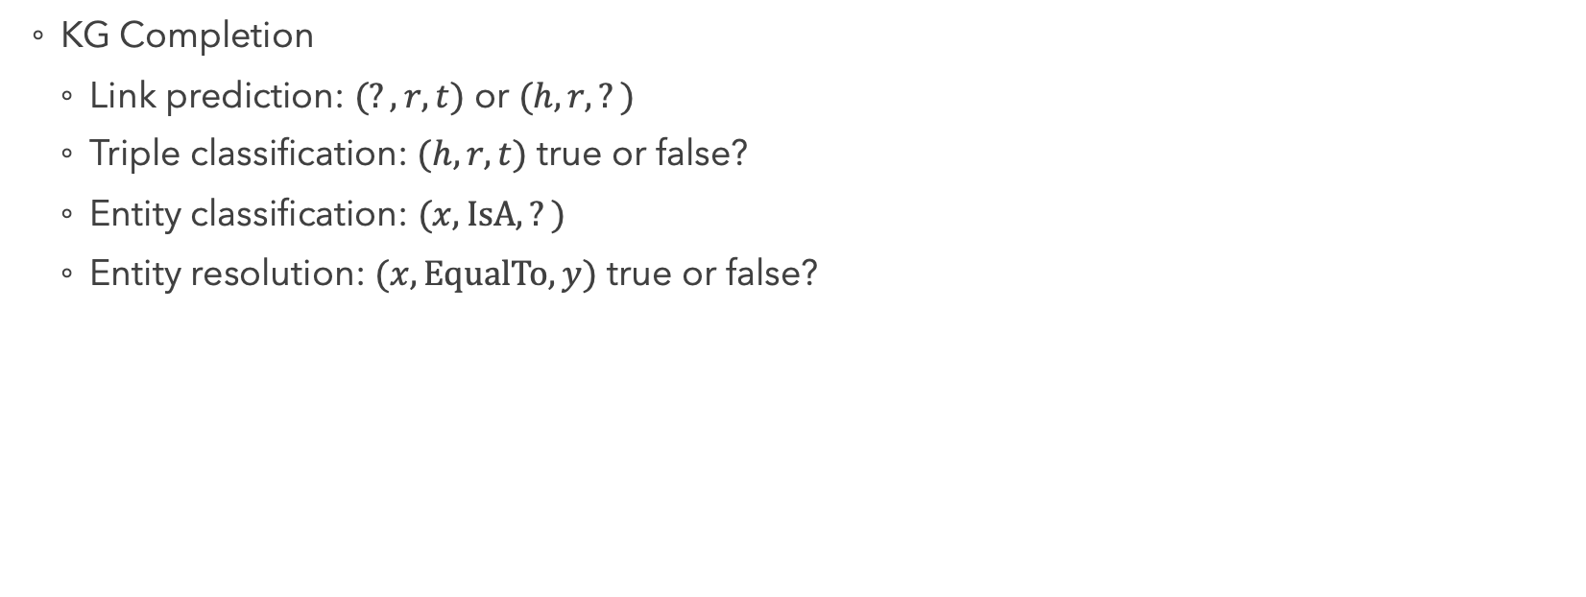
Knowledge Graph: Problems
KG Completion
Link prediction: $(?, r, t)$ or $(h, r, ?)$
Triple classification: $(h, r, t)$ true or false?
Entity classification: $(x, IsA, ?)$
Entity resolution: $(x, EqualTo, y)$ true or false?

Slide 10
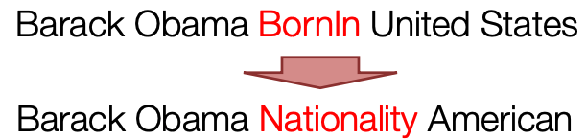
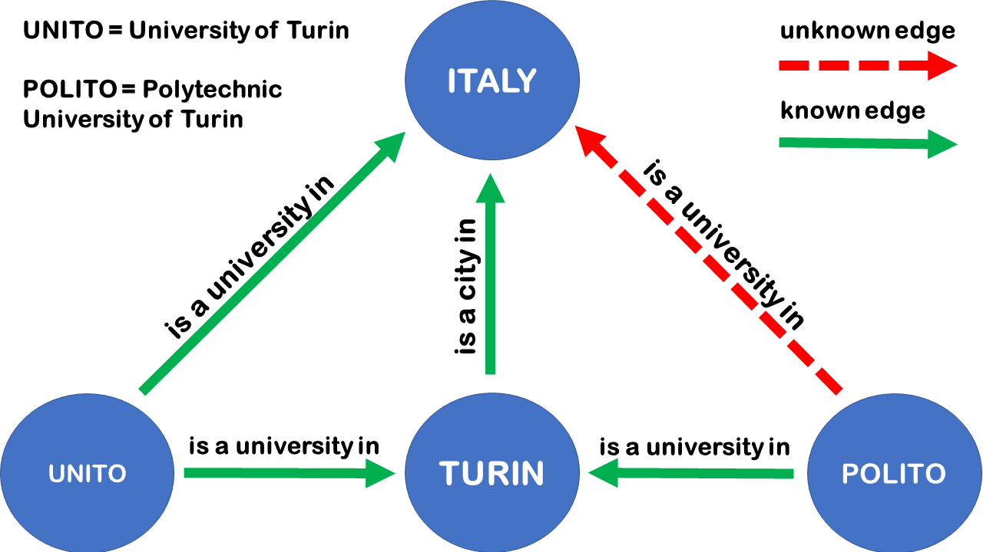
Knowledge Graph: Problems
KG Completion
https://web.stanford.edu/class/cs520/abstracts/leskovec.pdf
https://towardsdatascience.com/embedding-models-for-knowledge-graph-completion-a66d4c01d588

Slide 11
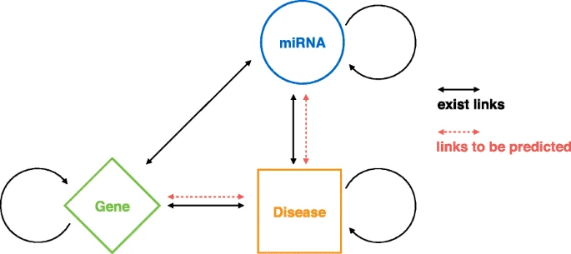
Knowledge Graph: Problems
KG Completion
Xiong, Yun, et al. "Heterogeneous network embedding enabling accurate disease association predictions." BMC medical genomics 12.10 (2019): 186.

Slide 12
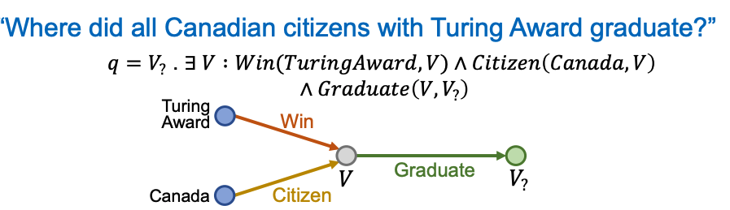
Knowledge Graph: Problems
Multi-hop queries
https://web.stanford.edu/class/cs520/abstracts/leskovec.pdf

Slide 13
Knowledge Graph: Problems
Out-of-KG Applications
Relation extraction
Question answering
Recommender systems

Slide 14
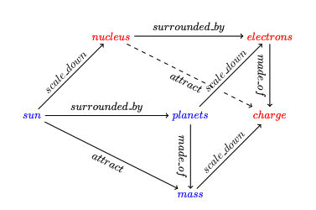
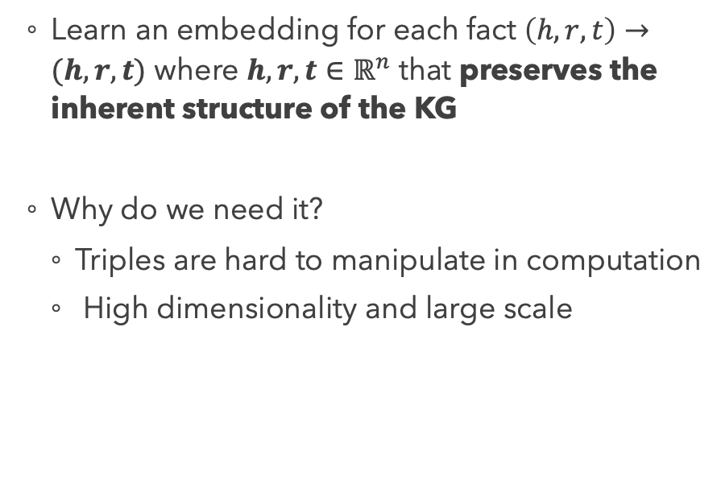
Knowledge Graph Embedding
Learn an embedding for each fact $\left(h, r, t\right)→(h, r, t)$ where $h, r, t∈ℝ^{n}$ that preserves the inherent structure of the KG
Why do we need it?
Triples are hard to manipulate in computation
High dimensionality and large scale
Liu, Hanxiao, Yuexin Wu, and Yiming Yang. "Analogical inference for multi-relational embeddings." arXiv preprint arXiv:1705.02426 (2017).

Slide 15
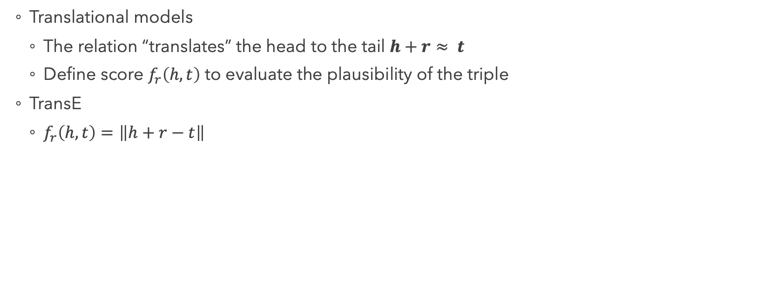
Translational KG Embedding
Translational models
The relation “translates” the head to the tail $h+r≈ t$
Define score $f_{r}\left(h,t\right)$ to evaluate the plausibility of the triple
TransE
$f_{r}\left(h,t\right)=\left\|h+r−t\right\|$
planets
electrons
surrounded_by
sun
nucleus

Slide 16
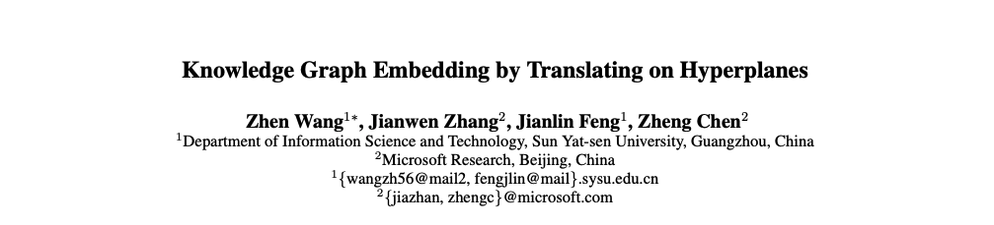
Paper 1

Slide 17
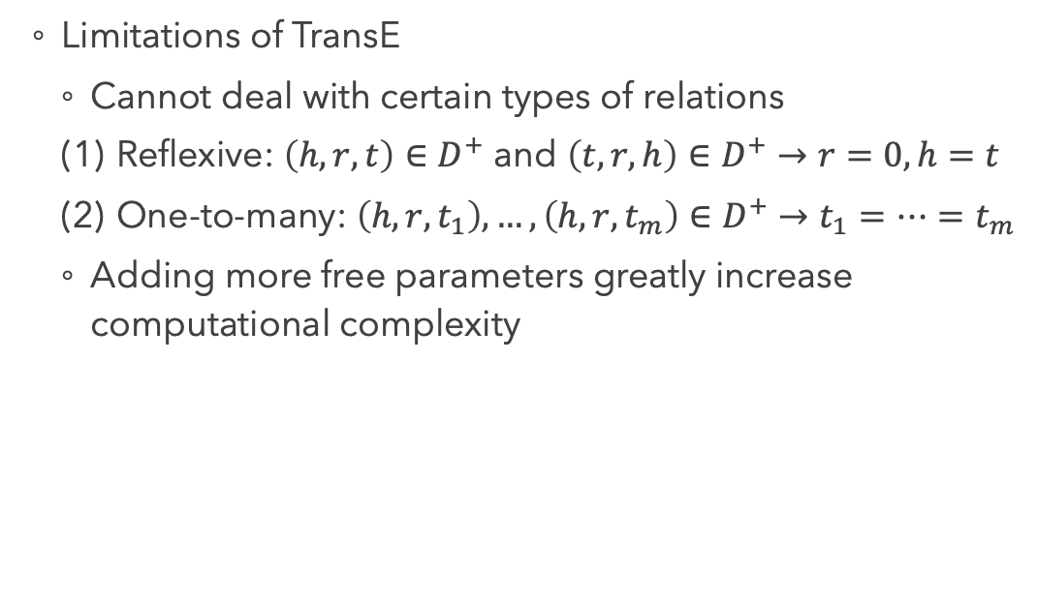
Motivations
Limitations of TransE
Cannot deal with certain types of relations
Reflexive: $\left(h, r, t\right)∈D^{+}$ and $\left(t, r, h\right)∈D^{+}$ $→r=0, h=t$
One-to-many: $\left(h, r, t_{1}\right),…,\left(h, r, t_{m}\right)∈D^{+}$ $→t_{1}=…=t_{m}$
Adding more free parameters greatly increase computational complexity
AnthonyPerkins
Psycho
Rebecca
RearWindow
.
.
.
starred_in
directed
AlfredHitchcock
Notes:
Also, relations and entities should not be placed in the same embedding space.

Slide 18
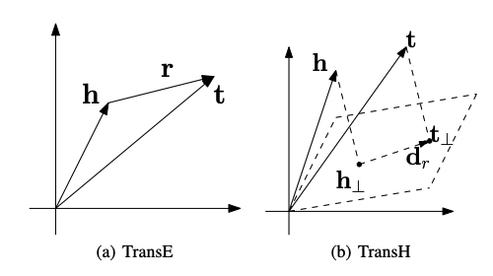
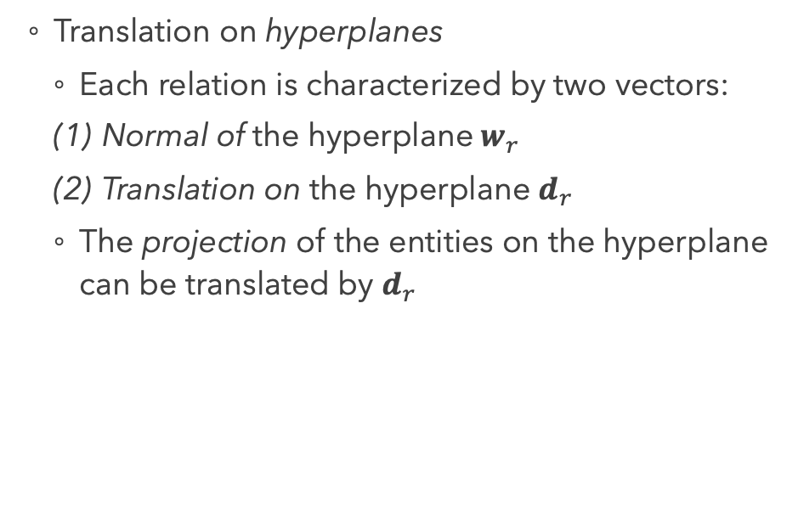
Methods
Translation on hyperplanes
Each relation is characterized by two vectors:
Normal of the hyperplane$w_{r}$
Translation on the hyperplane $d_{r}$
The projection of the entities on the hyperplane can be translated by $d_{r}$

Slide 19
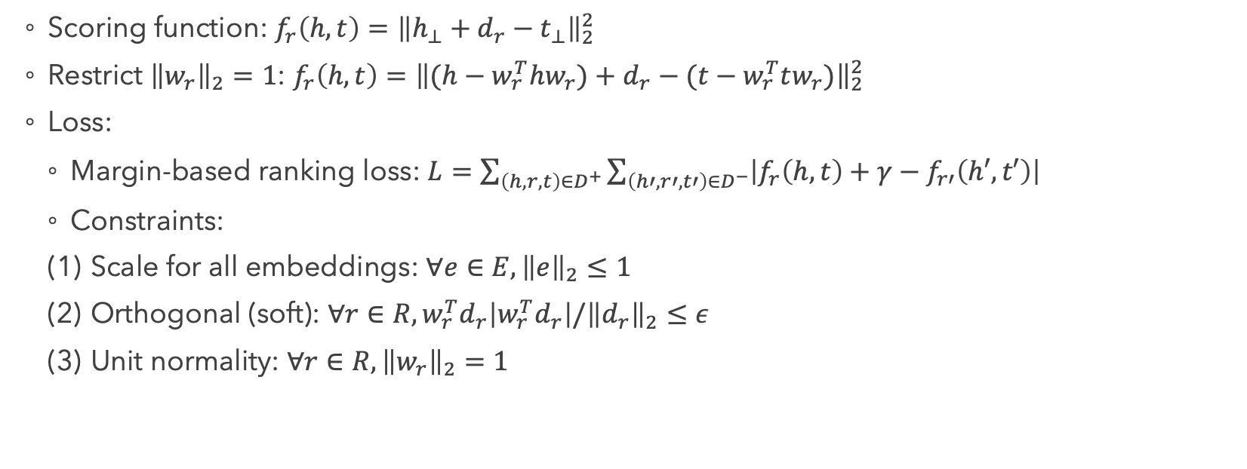
Training
Scoring function: $f_{r}\left(h,t\right)={\left\|h_{⊥}+d_{r}−t_{⊥}\right\|}_{2}^{2}$
Restrict ${\left\|w_{r}\right\|}_{2}=1$: $f_{r}\left(h,t\right)={\left\|(h−w_{r}^{T}hw_{r})+d_{r}−(t−w_{r}^{T}tw_{r})\right\|}_{2}^{2}$
Loss:
Margin-based ranking loss: $L=\sum_{\left(h,r,t\right)∈D^{+}}{\sum_{\left(h′,r′,t′\right)∈D^{−}}{\left|f_{r}\left(h,t\right)+γ−f_{r′}\left(h′,t′\right)\right|}}$
Constraints:
Scale for all embeddings: $∀e∈E, {\left\|e\right\|}_{2}≤1$
Orthogonal (soft): $∀r∈R,w_{r}^{T}d_{r}\left|w_{r}^{T}d_{r}\right|/{\left\|d_{r}\right\|}_{2}≤ε$
Unit normality: $∀r∈R,{\left\|w_{r}\right\|}_{2}=1$

Slide 20
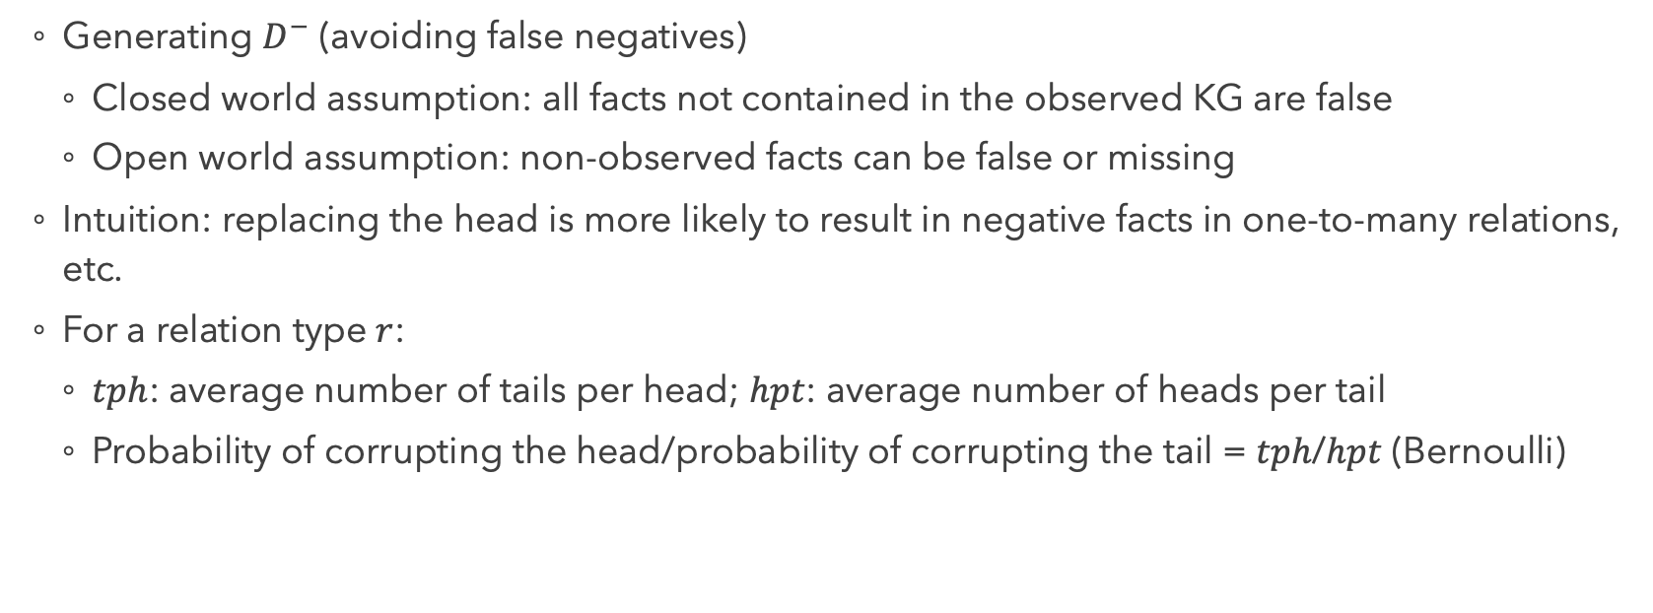
Training
Generating $D^{−}$ (avoiding false negatives)
Closed world assumption: all facts not contained in the observed KG are false
Open world assumption: non-observed facts can be false or missing
Intuition: replacing the head is more likely to result in negative facts in one-to-many relations, etc.
For a relation type $r$:
$tph$: average number of tails per head; $hpt$: average number of heads per tail
Probability of corrupting the head/probability of corrupting the tail = $tph$/$hpt$ (Bernoulli)

Slide 21
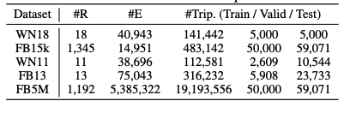
Experiments
Datasets
Link prediction
Triple classification
Notes:
WN: wordnet (hyponyms and hypernyms)
FB: freebase

Slide 22
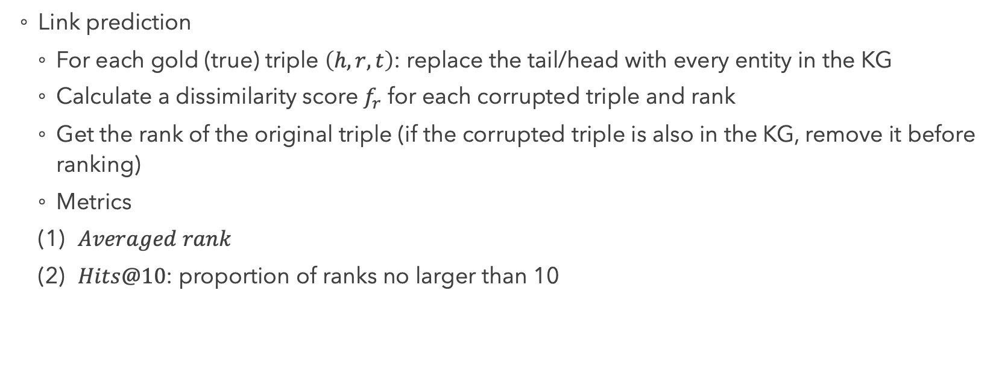
Experiments
Link prediction
For each gold (true) triple $\left(h, r, t\right)$: replace the tail/head with every entity in the KG
Calculate a dissimilarity score $f_{r}$ for each corrupted triple and rank
Get the rank of the original triple (if the corrupted triple is also in the KG, remove it before ranking)
Metrics
$Averaged rank$
$Hits@10$: proportion of ranks no larger than 10
Notes:
Notice: if the corrupted triple is also in the KG, ranking it higher than the original is not wrong

Slide 23
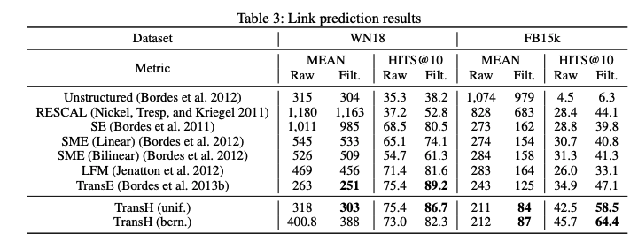
Experiments
Link prediction: Results
Notes:
SE: structured embeddings
SME: semantic matching energy
LTM: latent factor model
WN18 has fewer relation types

Slide 24
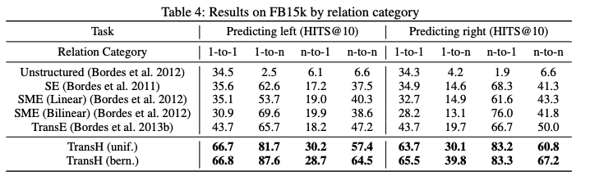
Experiments
Link prediction: Results

Slide 25
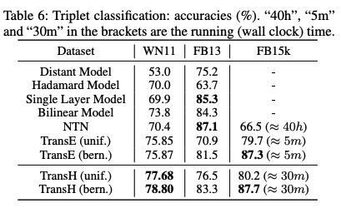
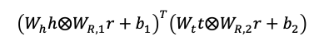
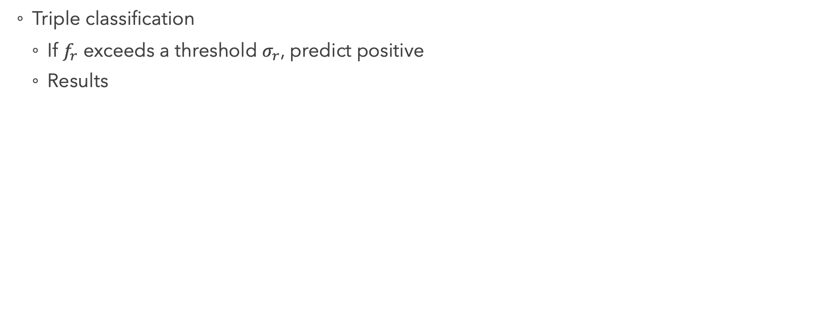
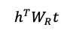
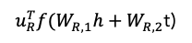
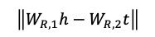
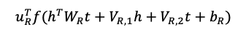
Experiments
Triple classification
If $f_{r}$ exceeds a threshold $σ_{r}$, predict positive
Results
$$\left\|W_{R,1}h−W_{R,2}t\right\|$$
$${\left(W_{h}h⨂W_{R,1}r+b_{1}\right)}^{T}\left(W_{t}t⨂W_{R,2}r+b_{2}\right)$$
$u_{R}^{T}f(W_{R,1}h+W_{R,2}$t)
$$h^{T}W_{R}t$$
$$u_{R}^{T}f(h^{T}W_{R}t+V_{R,1}h+V_{R,2}t+b_{R})$$
Notes:
NTN: neural tensor network
FB15k is much larger and training NTN is not efficient

Slide 26
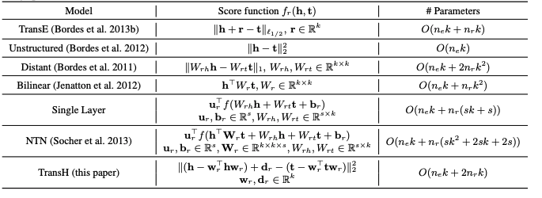
Experiments
Triple classification

Slide 27
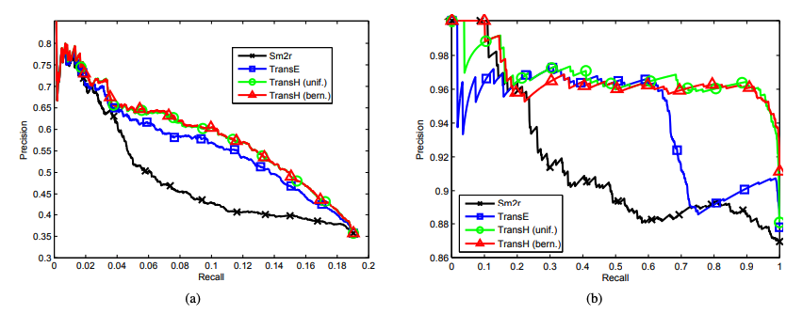
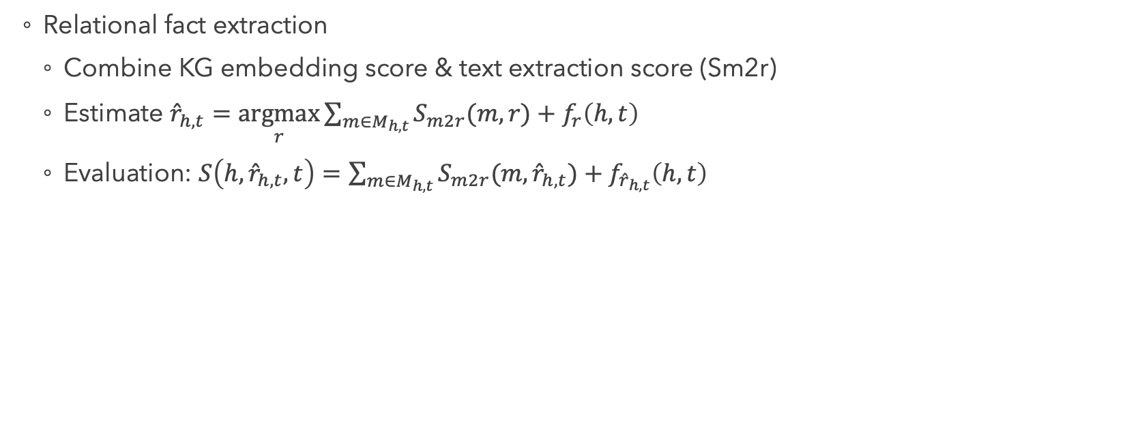
Experiments
Relational fact extraction
Combine KG embedding score & text extraction score (Sm2r)
Estimate ${\hat{r}}_{h,t}=\underset{r}{argmax}{\sum_{m∈M_{h,t}}{S_{m2r}(m,r)}}+f_{r}\left(h,t\right)$
Evaluation: $S\left(h,{\hat{r}}_{h,t},t\right)=\sum_{m∈M_{h,t}}{S_{m2r}(m,{\hat{r}}_{h,t})}+f_{{\hat{r}}_{h,t}}\left(h,t\right)$
Notes:
m: binary vector of words
Learn the mapping f (from binary words to vectors)
Combining TransE/TransH score with Sm2r
Using TransE/TransH score only for prediction (on relations accepted by Sm2r)
Sm2r: similarity between the relation mention vector $f(m)$ and the embedding vector $r$

Slide 28
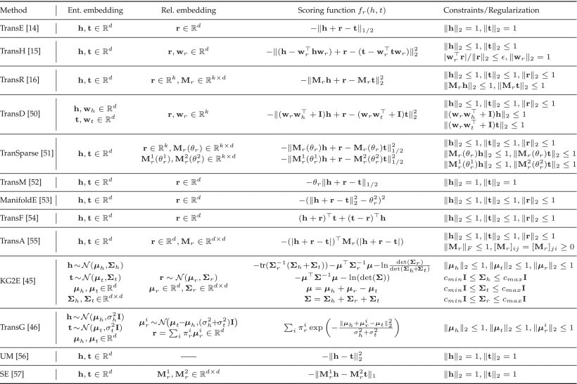

Slide 29
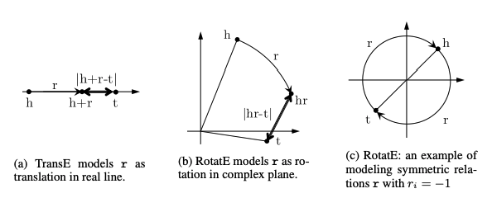
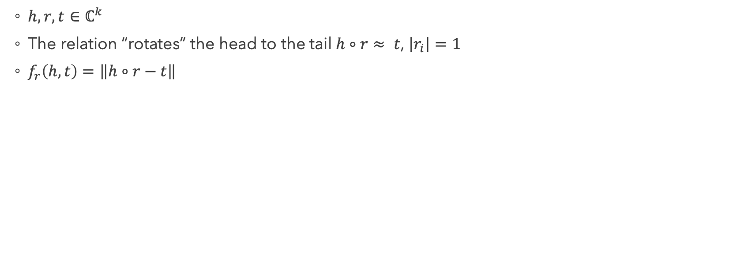
RotatE
$h,r, t∈ℂ^{k}$
The relation “rotates” the head to the tail $h∘r≈ t$, $\left|r_{i}\right|=1$
$f_{r}\left(h,t\right)=\left\|h∘r−t\right\|$
Sun, Zhiqing, et al. "Rotate: Knowledge graph embedding by relational rotation in complex space." arXiv preprint arXiv:1902.10197 (2019).
Notes:
Hadamard product
Deals with symmetric/inverse relations

Slide 30
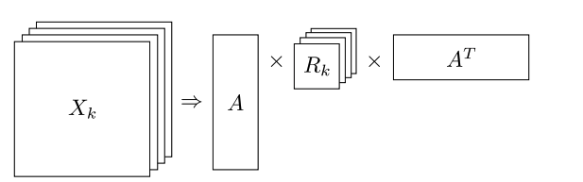
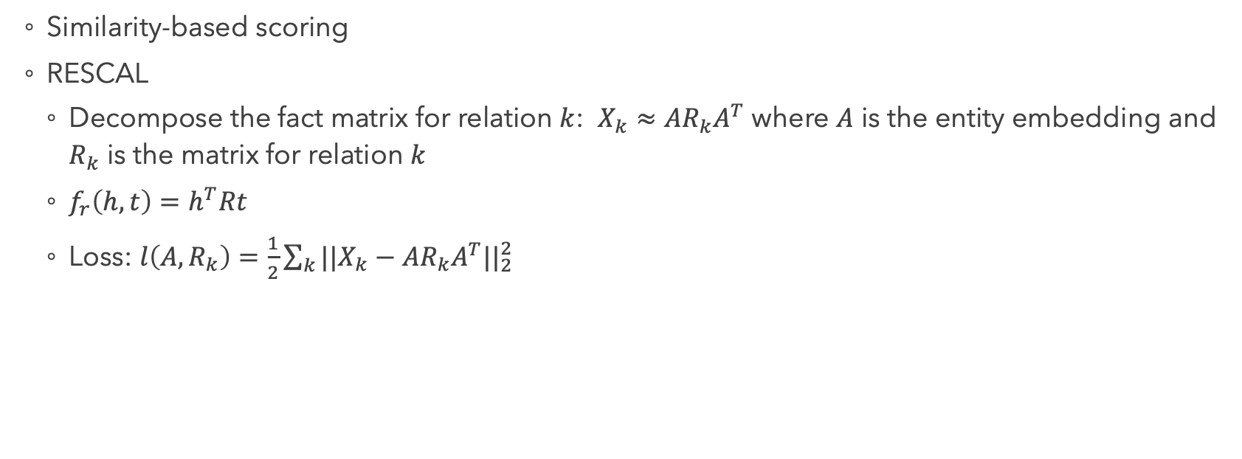
Similarity-based KG Embedding
Similarity-based scoring
RESCAL
Decompose the fact matrix for relation $k$: $X_{k}≈AR_{k}A^{T}$ where $A$ is the entity embedding and $R_{k}$ is the matrix for relation $k$
$f_{r}\left(h,t\right)=h^{T}Rt$
Loss: $l\left(A, R_{k}\right)=\frac{1}{2}\sum_{k}{||X_{k}}−AR_{k}A^{T}{||}_{2}^{2}$
http://www.cip.ifi.lmu.de/~nickel/data/slides-icml2011.pdf
Notes:
Matching latent semantics of entities and relations

Slide 31
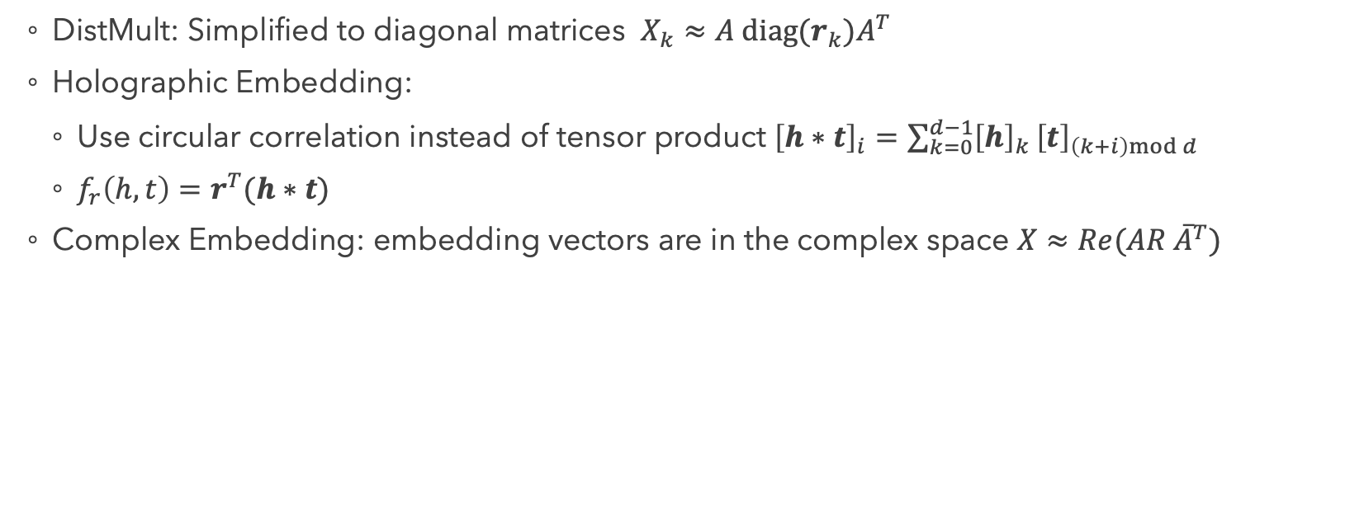
Similarity-based KG Embedding
DistMult: Simplified to diagonal matrices $X_{k}≈A diag(r_{k})A^{T}$
Holographic Embedding:
Use circular correlation instead of tensor product ${\left[h∗t\right]}_{i}=\sum_{k=0}^{d−1}{{\left[h\right]}_{k}}{\left[t\right]}_{\left(k+i\right)mod d}$
$f_{r}\left(h,t\right)=r^{T}(h∗t)$
Complex Embedding: embedding vectors are in the complex space $X≈Re(AR{ \overline{A}}^{T})$
http://www.cip.ifi.lmu.de/~nickel/data/slides-icml2011.pdf
Notes:
DistMult: Only deal with symmetric relations
Circular correlation: compress pairwise correlations (significantly reduce parameters, d^2 to d)
Complex: asymmetric relations
ComplEx is equivalent to HolE

Slide 32
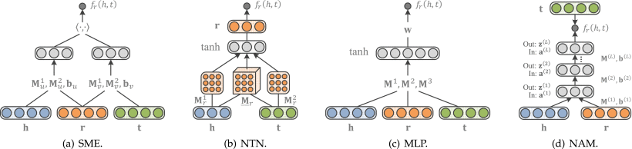
Similarity-based KG Embedding
Neural network-based semantic matching

Slide 33
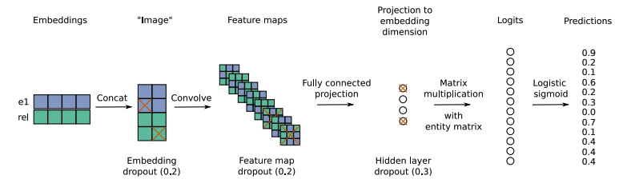
Similarity-based KG Embedding
ConvE

Slide 34
Discussion questions (1)
So far, all the mentioned models are based on “facts” (triples) only. What are the limitations?

Slide 35
Discussion questions (2)
How additional information can be incorporated to the KG embedding?
Graph contexts?
Entity attributes?

Slide 36
Incorporating Additional Information
Entity types: enforce entities of the same category to be similar
Graph contexts
Paths: model paths as a composition of relation embeddings
Graph CNN
Entity attributes
Temporal information

Slide 37
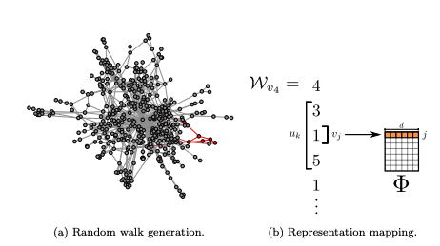
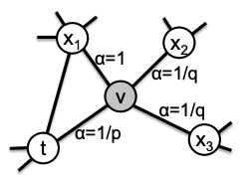
Modeling Graph Contexts
Random walk
Sample random paths from the graph then treat them as sentences
DeepWalk:
Sample random walks uniformly
Train Skip-gram on the walks
Node2vec: add second-order search bias
Perozzi, Bryan, Rami Al-Rfou, and Steven Skiena. "Deepwalk: Online learning of social representations." Proceedings of the 20th ACM SIGKDD international conference on Knowledge discovery and data mining. 2014.
Grover, Aditya, and Jure Leskovec. "node2vec: Scalable feature learning for networks." Proceedings of the 22nd ACM SIGKDD international conference on Knowledge discovery and data mining. 2016.

Slide 38
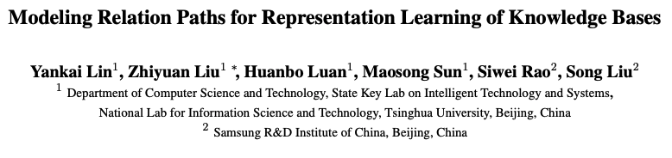
Paper 2

Slide 39
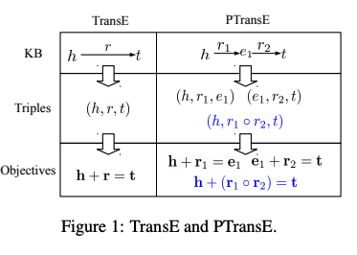
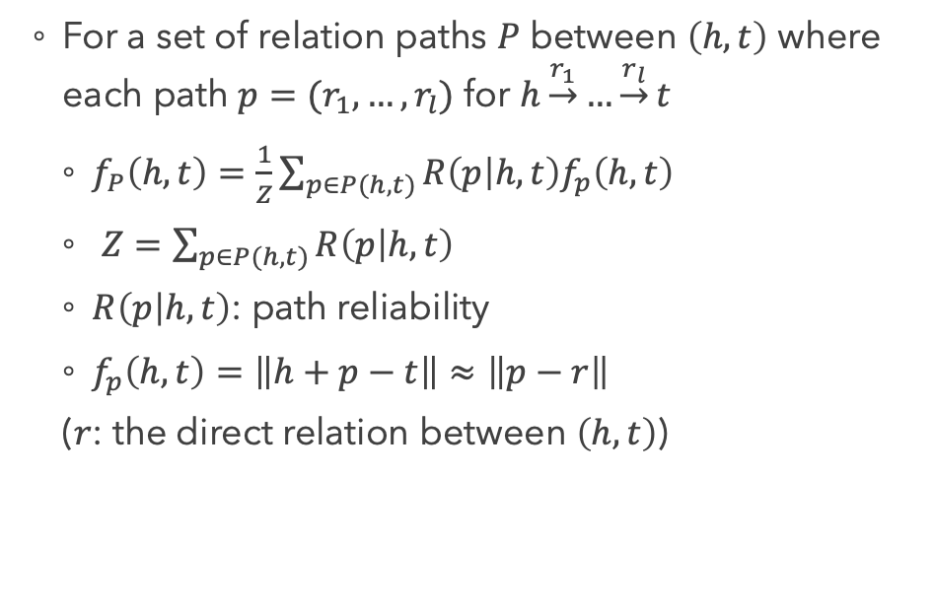
Methods
For a set of relation paths $P$ between $\left(h,t\right)$ where each path $p=(r_{1}, …, r_{l})$ for $h\underset{→}{r_{1}}…\underset{→}{r_{l}}t$
$f_{P}\left(h,t\right)=\frac{1}{Z}\sum_{p∈P(h,t)}{R\left(p | h,t\right)f_{p}\left(h,t\right)}$
$Z=\sum_{p∈P(h,t)}{R\left(p | h,t\right)}$
$R\left(p | h,t\right)$: path reliability
$f_{p}\left(h,t\right)=\left\|h+p−t\right\|≈\left\|p−r\right\|$
($r$: the direct relation between $\left(h,t\right)$)
Notes:
Reliability: path-constraint resource allocation (PCRA)

Slide 40


Methods
Composition operations:
Addition assumption: $p= r_{1}+r_{2}+…$
Multiplication assumption: $p=r_{1}∘r_{2}∘…$
RNN: $c_{i}=f\left(W\left[c_{i−1};r_{i}\right]\right), p=c_{n}$

Slide 41

Methods
Reliability measure
Each node transmits “resources” equally to its successors
$S_{0}\underset{→}{r_{1}}S_{1}\underset{→}{r_{2}}…\underset{→}{r_{l}}S_{l}$ where $h=S_{0}, t∈S_{l}$
Resource flowing to node $m$: $R_{p}\left(m\right)=\sum_{n∈S_{i−1}(⋅,m)}{\frac{1}{\left|S_{i}\left(n,⋅\right)\right|}R_{p}(n)}$
Measure the reliability by the resource that eventually flows from the head to the tail
$${R\left(p | h,t\right)=R}_{p}\left(t\right)$$

Slide 42

Methods
Objective: $L\left(S\right)=\sum_{\left(h,r,t\right)∈S}{[L(h,r,t)+\frac{1}{Z}\sum_{p∈P\left(h,t\right)}{R\left(p | h,t\right)L(p,r)}]}$
$L(h,r,t)$ and $L(p,r)$: margin-based ranking loss w.r.t $f_{r}\left(h,t\right)$ and $f_{p}\left(h,t\right)$
Constraints: ${\left\|h\right\|}_{2},{\left\|r\right\|}_{2},{\left\|t\right\|}_{2}≤1$
Reverse relations: only consider graphs following one direction
$e_{1}\underset{→}{BornIn}e_{2}\underset{←}{CityOfCountry}e_{3}$ $⇒$ $e_{1}\underset{→}{BornIn}e_{2}\underset{→}{CityOfCountry^{−1}}e_{3}$
Limit to 3-step paths

Slide 43

Experiments
Datasets

Slide 44

Experiments
KG completion (prediction of entities or relations)
Score $S\left(h,r,t\right)=G\left(h,r,t\right)+G(t,r^{−1},h)$
$G\left(h,r,t\right)$= $\left\|h+r−t\right\|+\frac{1}{Z}\sum_{p∈P(h,t)}{Pr⁡(r|p)R\left(p | h,t\right)\left\|p−r\right\|}$
Notes:
Raw: naïve corrpution
Filter: remove corrupted triple if it is still in the KG
Pr(r|p)=Pr(r,p)/Pr(p)

Slide 45


Experiments
Entity prediction
Notes:
TransR: relation as projection matrix (Mr)

Slide 46

Experiments
Relation prediction
Notes:
+Rev: adding reverse relations for testing
+Path: adding paths for testing
-TransE: only using paths
-Path: only using TransE

Slide 47


Experiments
Relation extraction

Slide 48
Discussion questions (3)
How do we extend beyond edges (tripes) and paths?
Notes:
1. Consider subgraph structures? How?

Slide 49

Modeling Graph Contexts
Graph Neural Network
GCNN
https://tkipf.github.io/graph-convolutional-networks/.

Slide 50

Paper 3

Slide 51


Methods
GCN
$h_{i}^{(l+1)}=σ(\sum_{m∈M_{l}}{\sum_{j∈N_{i}}{{g_{m}(h}_{i}^{\left(l\right)},h_{j}^{\left(l\right)})}})$
Relational GCN
$h_{i}^{(l+1)}=σ(\sum_{r∈R}{\sum_{j∈N_{i}^{r}}{\frac{1}{c_{i,r}}W_{r}^{\left(l\right)}h_{j}^{\left(l\right)}+W_{0}^{\left(l\right)}h_{i}^{\left(l\right)}}})$
Regularization
Basis decomposition: $W_{r}^{(l)}=\sum_{b}{a_{rb}^{(l)}V_{b}^{(l)}}$
Block-diagonal decomposition: $W_{r}^{(l)}=⨁_{b}{Q_{br}^{(l)}}$
Notes:
Basis: combination of basis transformations
Block: direct sum of several low dimensional matrices (Wr is a block diagonal)

Slide 52


Experiments
Entity classification
Softmax per node on the output of the last layer
Cross-entropy loss
Datasets:
Ristoski, Petar, Gerben Klaas Dirk De Vries, and Heiko Paulheim. "A collection of benchmark datasets for systematic evaluations of machine learning on the semantic web." International Semantic Web Conference. Springer, Cham, 2016.
Notes:
AIFB: staff, group, publications of AIFB institute
MUTAG: molecular graphs (links are chemical bonds or existence of a property)
BGS: rock types with hierarchical features
AM: artifacts in Amsterdam Museum (links to other artifacts and some details)
(Only for nodes that have labels)

Slide 53

Experiments
Entity classification: results
Performance on MUTAG and BGS could be improved by adding an attention mechanism (esp. for high-degree nodes)
Notes:
Feat: node feature only
WL: weisfeiler-lehman kernel (propagation scheme on graphs, create an ordered string starting from a node, then hash them to create updated compressed node labels)
RDF2Vec: random walk on graph + skipgram
For MUTAG and BGS, labelled entities are connected through high-degree hubs -> Normalization during aggregation may impair the performance -> attention might help

Slide 54


Experiments
Link prediction
Graph autoencoder
Encoder: map each entity to a vector $e_{i}∈ℝ^{d}$
Decoder: reconstruct the graph edges from the node embeddings
DistMult factorization: $X_{k}≈A diag(r_{k})A^{T}$
Score $f_{r}\left(h,t\right)=h^{T}diag\left(r\right)t$
Cross entropy loss
$$L=−\frac{1}{(1+ω)\left|D^{+}\right|}\sum_{\left(h,r,t,y\right)∈T}{y\log{σ\left(f_{r}\left(h,t\right)\right)}+\left(1−y\right)}(1−\log{σ\left(f_{r}\left(h,t\right)\right))}$$
Notes:
Omega: ratio of neg/pos
Random corrpution

Slide 55


Experiments
Link prediction: results
FB15k-237
Notes:
R-GCN+: ensemble of R-GCN and DistMult
FB15k and WN18: local & long-distance information are both important -> R-GCN+ performs better
FB15k-237: reduced FB15k, problematic inverse relations removed (local information less salient)
CP: canonical polyadic decomposition (decompose the three-way tensor into λkakºbkºck, outer product X(i,j,k)=a(i)b(j)c(k))
R-GCN does not explicitly model asymmetric relations

Slide 56

Paper 4

Slide 57

Model
Relation
Path

Slide 58

Experiments
Link predictions
Notes:
HypER: some improvement over ConvE
TuckER: tensor factorization

Slide 59

Experiments
Link predictions

Slide 60


Experiments
Path (multi-hop) queries
$s→r_{1}→r_{2}→r_{3}→…→?$ (e.g. $Obama→HasChild→LivesIn→?$: Where does Obama’s child live?)
Notes:
Compositional models
Path-RNN, ROP: RNN
Training CoKE with different path lengths

Slide 61

Experiments
Path (multi-hop) queries
Training on multi-hop paths also improves single-hop reasoning

Slide 62

Visualizations
Notes:
Feed the triples to the model
T-SNE of the embedding of an entity (TheKingsSpeech) or relation (DirectorOf/DirectedBy) within different contexts (triples)

Slide 63
Discussion questions (4)
How do we deal with unseen entities?

Slide 64
Discussion questions (5)
How do we deal with heterogeneity?

Slide 65
Discussion questions (5)
How could KG embedding be applied to natural language tasks?

Slide 66
Merci

Slide 67

General Graph Embedding
Matrix factorization
Presence of an edge can be predicted from the latent attributes (embeddings) of the nodes
Graph factorization: $f\left(Y, Z, λ\right)=\frac{1}{2}\sum_{\left(i,j\right)∈E}{{(Y_{ij} − \left\langle Z_{i}, Z_{j}\right\rangle )}^{2}})+\frac{λ}{2}\sum_{i}{{\left\|Z_{i}\right\|}^{2}}$ where $Y_{ij}$ is the indicator of edge $(i, j)$ and $Z_{i}$ is the embedding of node $i$
Ahmed, Amr, et al. "Distributed large-scale natural graph factorization." Proceedings of the 22nd international conference on World Wide Web. 2013.

